Slide 1
Model Building Using Word2Vec
NLP using CRISP-DM Methodology
Jeremy Bergmann - Omaha Data Science Academy

Slide 2
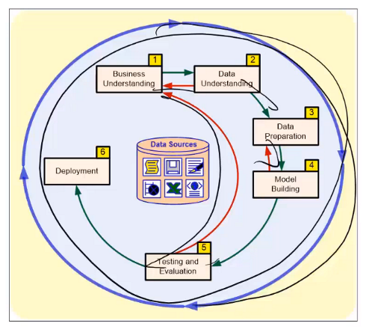
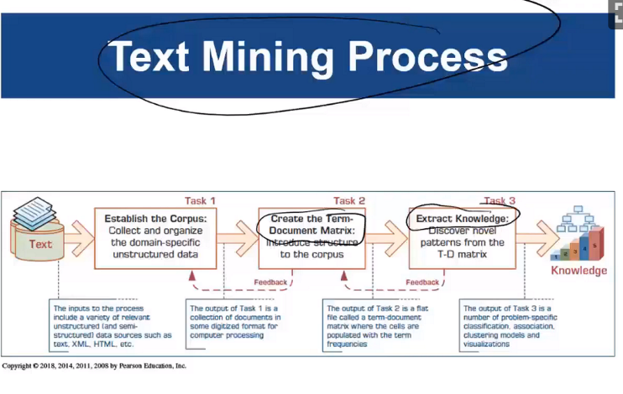
Text Mining & NLP Recap
CRISP-DM Process - The CRISP-DM process outlines the steps involved in performing a data science project, from business need to deployment.
Also, it indicates that data science is an iterative process that requires continual evaluation and improvement.
Text Mining - Similar to Data Mining, which is the “non-trivial process of identifying valid, novel useful and understandable patterns” in unstructured, text-based data sources.
Notes:
Unstructured data - information that either does not have a pre-defined data model or is not organized in a pre-defined manner. Unstructured information is typically text-heavy, but may contain data such as dates, numbers, and facts as well. (80-90% of firm’s data)

Slide 3
Business & Data Understanding
Business Understanding
Understanding the business goal
Situation assessment/feasibility
Translating the business goal in a data mining objective
Development of a project plan
Data Understanding
Considering data requirements
Exploration & Understanding
Quality assessment
Determine “repeatability”
Leads to
Source: https://www.sv-europe.com/crisp-dm-methodology/

Slide 4
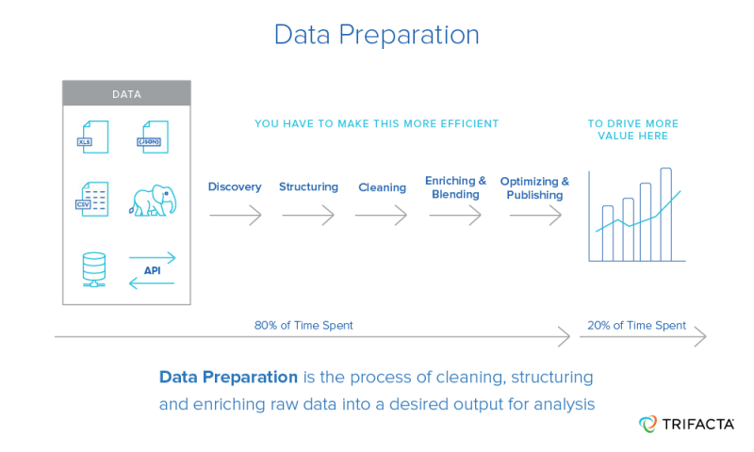
Data Preparation
Data preparation
Selection of required data
Data acquisition
Data integration and formatting
Data cleaning
Data transformation and enrichment
Data Optimization
Python Data Prep Packages
Pandas: https://pandas.pydata.org/
Numpy: https://docs.scipy.org/doc/numpy/user/quickstart.html
Notes:
Challenges in NLP: speech recognition, natural language understanding, and natural language generation.

Slide 5
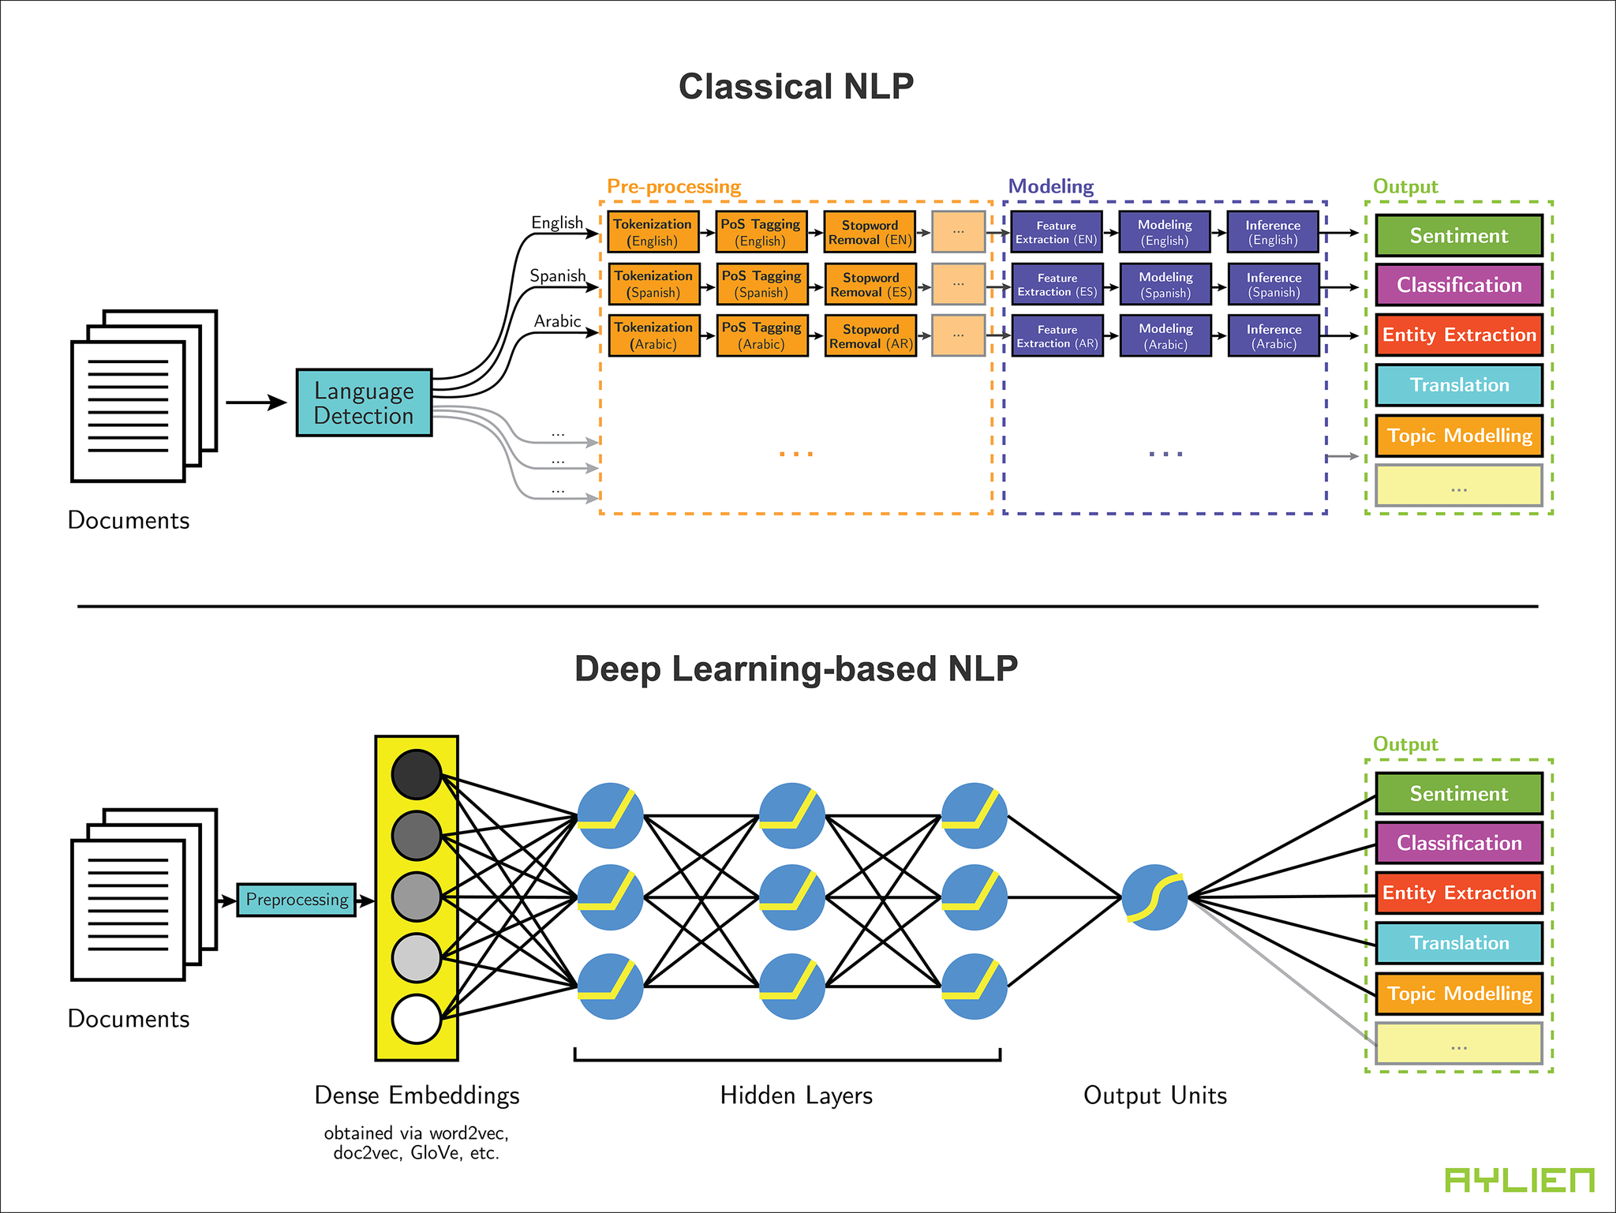
Model Building
Natural Language Processing (NLP) Modeling
Model Building
Selection of appropriate modeling technique(s)
Splitting dataset training/testing subsets for evaluation purposes
Development and examination of modeling algorithms - Model Comparison
Fine tuning model performance
https://pbs.twimg.com/media/DKhVVszUIAAUl6f.png:large
Notes:
Key difference is in goal - grouping/classification (text mining) vs. meaning & context (NLP)
NLP Introduction: https://blog.algorithmia.com/introduction-natural-language-processing-nlp/

Slide 6
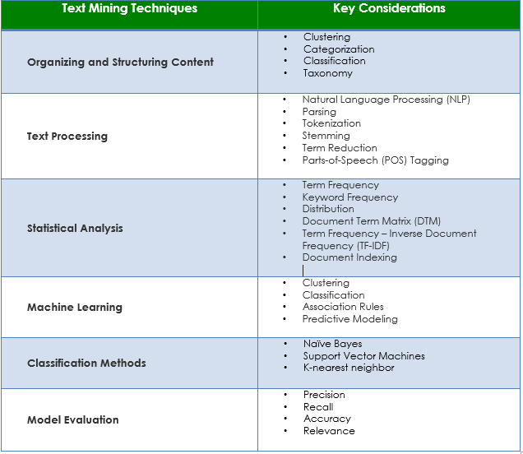
Model Testing & Evaluation
Model Testing & Evaluation
Evaluation of the model in the context of the business success criteria
Model Performance
Text Mining & NLP Model Output “Objective” and “Sense”
Model review & approval
Key: Evaluation of the model is highly depended on the modeling technique!
Notes:
Other word2vec overview links: https://skymind.ai/wiki/word2vec,
Skipgram algorithm: http://mccormickml.com/2016/04/19/word2vec-tutorial-the-skip-gram-model/

Slide 7
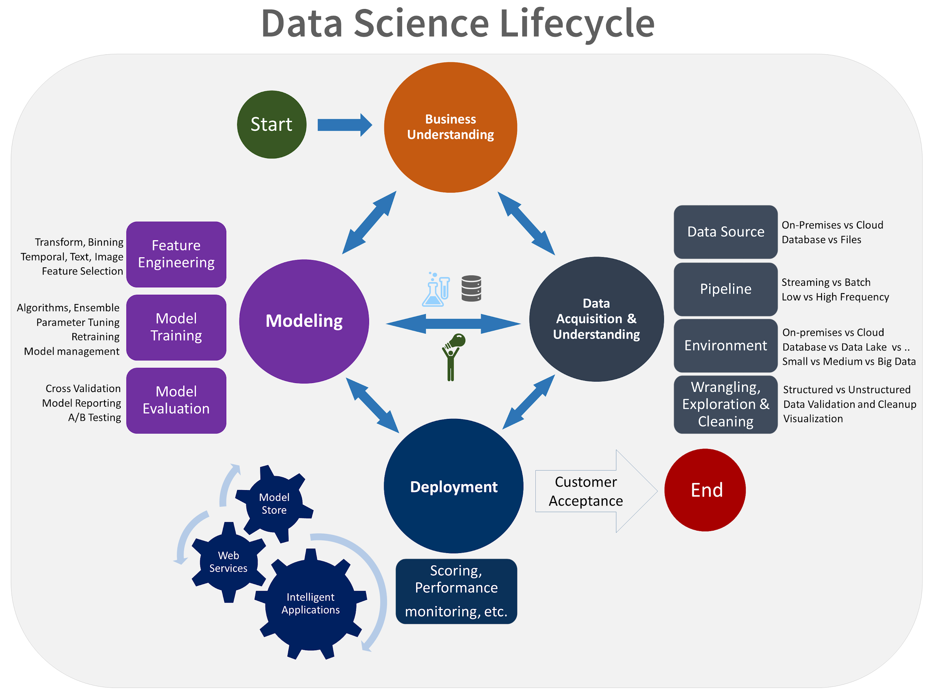
Model Deployment & Beyond
Model Deployment
Create/present report of findings
Planning and development of the deployment procedure(s)
Create Workflow and Deploy data science model
Integration into an organisation’s system(s)
Development of a maintenance / update plan
Review of the project objective & outcomes
Planning the “next steps”
Key: CRISP-DM is an iterative approach to Data Science Projects, requiring continual evaluation and improvement after deployment!
Notes:
Other word2vec overview links: https://skymind.ai/wiki/word2vec,
Skipgram algorithm: http://mccormickml.com/2016/04/19/word2vec-tutorial-the-skip-gram-model/

Slide 8
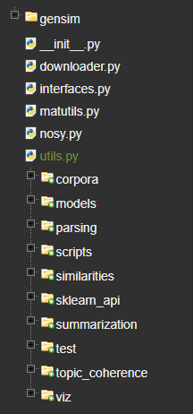
Gensim Word2Vec Package
Package Contents
Data Prep: Corpora and Vector Spaces
Data Understanding: Similarity Queries
Model Building: Topics and Transformations
Model Deployment: Distributed Computing
Model Documentation https://radimrehurek.com/gensim/tut2.html#available-transformations
Notes:
Key difference is in goal - grouping/classification (text mining) vs. meaning & context (NLP)
NLP Introduction: https://blog.algorithmia.com/introduction-natural-language-processing-nlp/

Slide 9
Gensim Word2Vec Models
Model Documentation https://radimrehurek.com/gensim/tut2.html#available-transformations
Word2Vec NLP Models (Input Vectors)
Term Frequency * Inverse Document Frequency, Tf-Idf (Bag-Of-Words)
Intended to reflect how important a word is to a document in a collection or corpus
Latent Semantic Indexing, LSI (or sometimes LSA) (Bag-of-words/tfldf-weighted space)
LSI is being used in a variety of information retrieval and text processing applications, although its primary application has been for concept searching and automated document categorization
Random Projections, RP (tfldf-weighted space)
Powerful method for dimensionality reduction “Simplifiying Data”
Latent Dirichlet Allocation, LDA (Bag-Of-Words)
Allows sets of observations to be explained by unobserved groups that explain why some parts of the data are similar
Hierarchical Dirichlet Process, HDP (Bag-Of-Words) - Experimental Use

